Slide 1
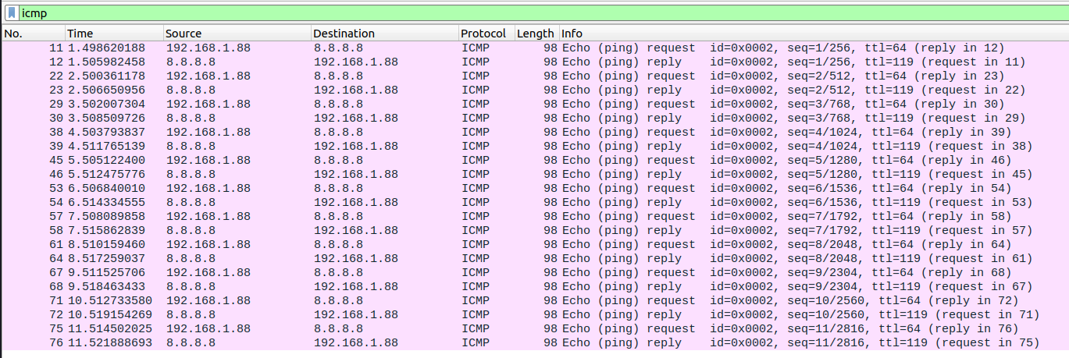
Command: ping 8.8.8.8
Protocol: ICMP
SRC : My Private IP
DIST : 8.8.8.8 (google)
PORT: N/A, ICMP is L3
TRAFFIC: Bidirectional

Slide 2
Command: Nslookup wikipedia.org
Protocol: DNS
SRC : My Private IP
DIST : Default gateway (router)
PORT: 53/UDP
TRAFFIC: Bidirectional

Slide 3
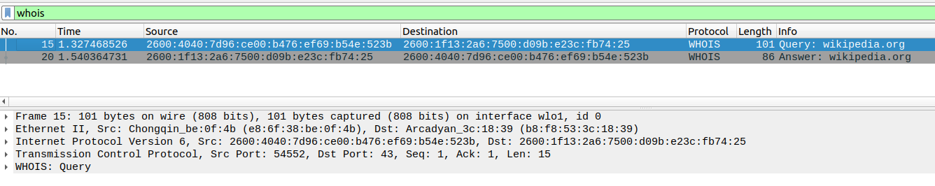
Command: whois wikipedia.org
Protocol: whois
SRC : My Private IPv6
DIST : Default gateway (router)
PORT: 43/TCP
TRAFFIC: Bidirectional

Slide 4
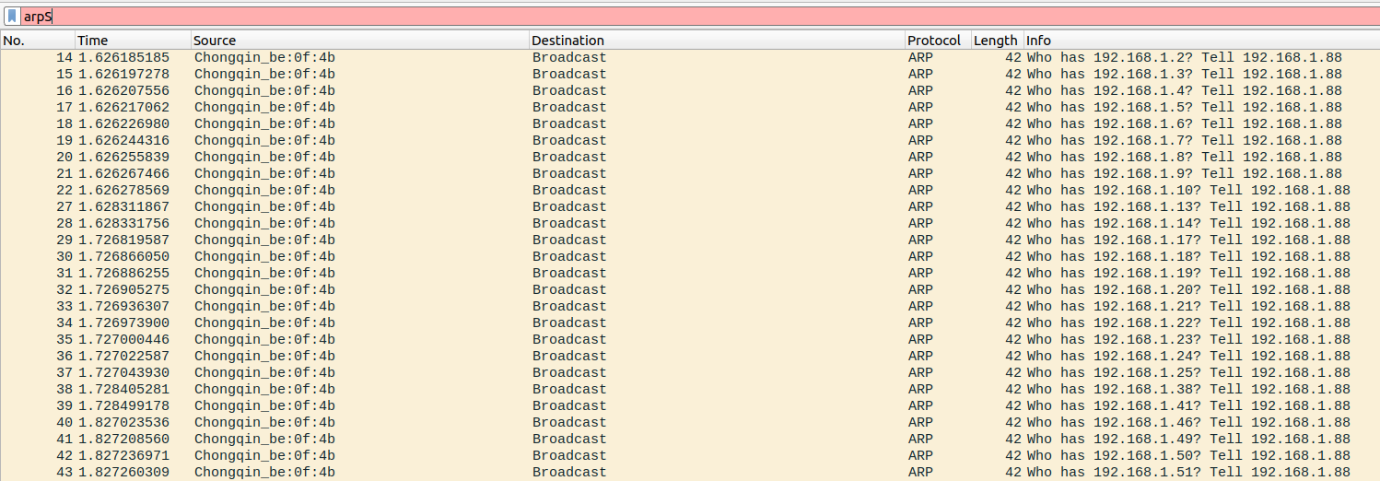
Command: nmap -sP 192.168.1.1-255
Protocol: ARP
SRC : My MAC Address
DIST : BROADCAST MAP
PORT: No Port (Layer 2)
TRAFFIC: Bidirectional

Slide 5
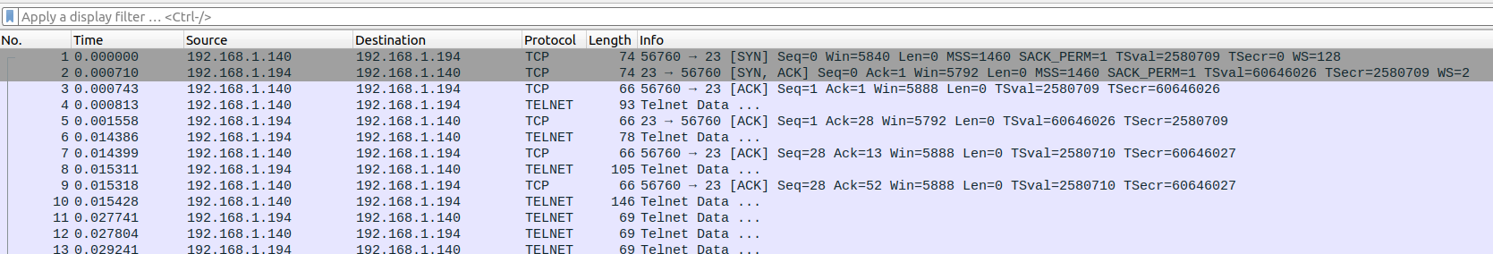
Command: telnet
Protocol: TELNET (L5)
SRC : My Private IP
DIST : 192.168.1.194
PORT: 23/TCP
TRAFFIC: Bidirectional

Slide 6
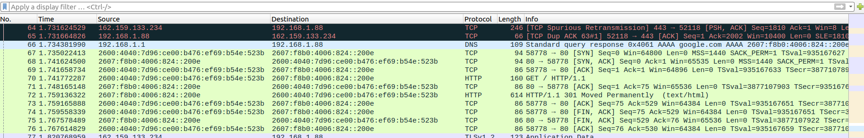
Command: curl https://everything.curl.dev/
Protocol: HTTP (L5)
SRC : My Private IPv6
DIST : An IPv6 in Google’s block
PORT: 80/TCP
TRAFFIC: Bidirectional – Mostly Ingress
This Image contains a
HTTP exchange.

Slide 7
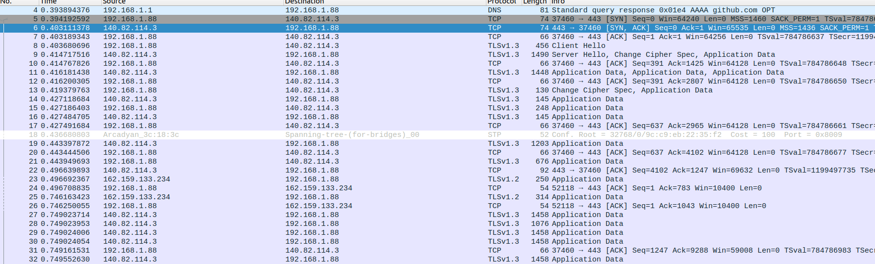
Command: wget -P ./Downloads/ https://github.com/Parth099/BattleShip.git
Protocol: HTTPS (L5)
SRC : My Private IP
DIST : An IP part of Githubs block
PORT: 443/TCP
TRAFFIC: Bidirectional – Mostly Ingress
This Image contains a
TCP-Handshake

Slide 8
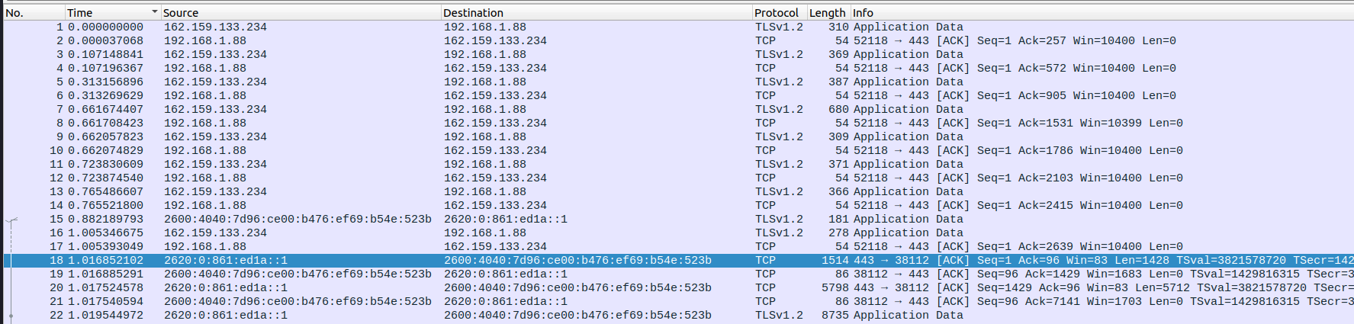
HTTPS: https://en.wikipedia.org/wiki/HTTPS
Protocol: HTTPS (L5)
SRC : My Private IP
DIST : An IP part of Wikipedia’s block
PORT: 443/TCP
TRAFFIC: Bidirectional – Mostly Ingress
This Image contains a
HTTPS-Handshake

